Slide 1
Sequencing instruments
2025-02-19

Slide 2


Outline
Background
Major sequencing methods
1st gen, 2nd gen, 3rd gen
Quality Control (QC)
Multihealing
Assembly concepts
Notes:
1st gen Sanger
2nd gen 454 (x), SOLiD (x), Illumina
3rd gen PacBio, ONT
x => out of date

Slide 3
Prokaryotic Sequencing Projects
Stages
Examples
Sequencing
Assembly
Feature prediction
Functional annotation
…analysis…
Display (Genome Browser)
Haemophilus influenzae
Neisseria meningitidis
Bordetella bronchisceptica
Vibrio cholerae
Listeria monocytogenes
Sequencing
prediction
annotation
Display
Assembly
Fleischman et al. (1995) “Whole-Genome Random Sequencing and Assembly of Haemophilus influenzae Rd” Science 269:5223
Kislyuk et al. (2010) “A computational genomics pipeline for prokaryotic sequencing projects” Bioinformatics 26:15

Slide 4
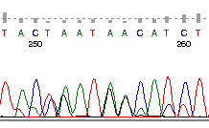

Sanger sequencing
Sequencing by terminator nucleotides (ddNTPs)
Initiated with primers
Common software:
Base calling: Phred
Assembly: phrap, cap3, and others
Upsides
Targeted sequencing
Long reads: 700bp+, sometimes 1kb+
Downsides
Low throughput
Lots of hands on time
https://linsalrob.github.io/ComputationalGenomicsManual/Sequencing/
Notes:
https://linsalrob.github.io/ComputationalGenomicsManual/Sequencing/
For a whole genome sequencing project this would take years and millions of dollars and a whole team

Slide 5
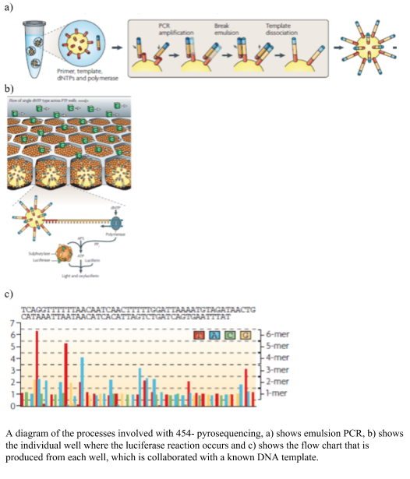
454 (2nd gen) - deprecated
Sequencing by illumination
Emulsion PCR
Sequencing is a cycle of
Observe positions of reads on slide
Wash a single nt over slide
Observe where it lights up
Advantages
long(er) reads 400-800bp
Disadvantages
homopolymer errors

Slide 6
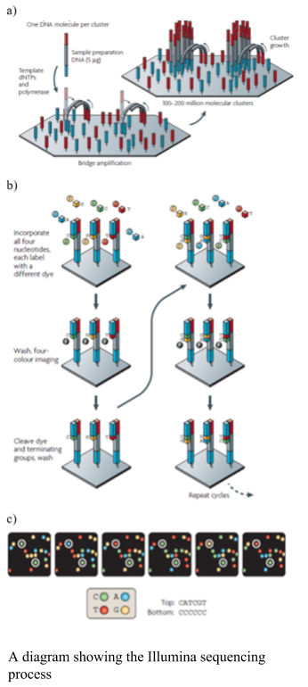
Illumina (2nd gen)
Template strand glued to a slide
Sequencing cycle:
Fluorescent dNTP added
Camera sees where each dNTP is added
Fluorophore washed away
150 or 250bp usually
Paired end
Rob Edwards teaching Illumina: https://www.youtube.com/watch?v=mLZqS0RYqCk
Notes:
Rob Edwards teaching it: https://www.youtube.com/watch?v=mLZqS0RYqCk

Slide 7
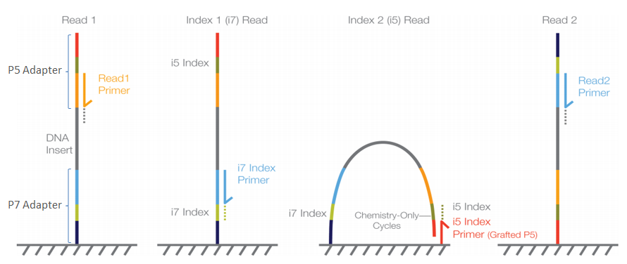
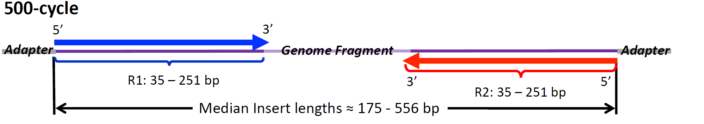
Illumina paired end sequencing

Slide 8
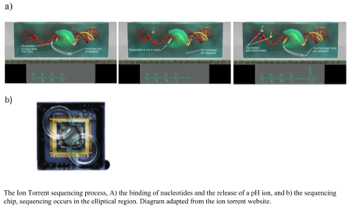
Ion Torrent (2nd or 3rd gen)
“sequencing on a chip”
Similar to 454 but measure pH output instead of light
Homopolymer errors
Fast sequencing time but long library prep time

Slide 9
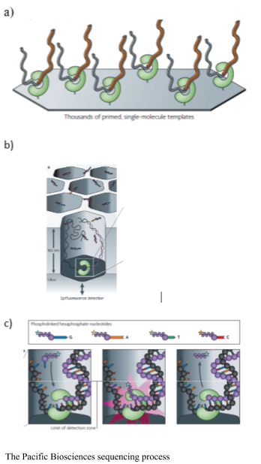
Pacific BioSciences (PacBio) - 3rd gen
Single DNA read in a small well called a zero-mode waveguide detector
DNA polymerase stuck on bottom of well
Laser reads the polymerase as it synthesizes from the template strand

Slide 10
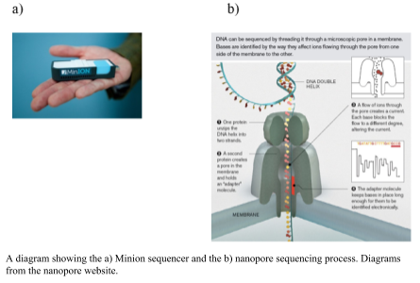
Oxford Nanopore Technologies (ONT) - 3rd gen
Single DNA pushed through a nanopore
Electrical resistances measured as the DNA goes through the pore
Large indel rate
Can get very long reads with high coverage, which overcomes large error rate

Slide 11
Technologies pros and cons
Illumina
Pro - accurate sequencing
Con - long run time + shorter reads
454
Pro - long reads + 8 hour run
Con - homopolymer errors
Ion Torrent
Pro - long reads + 2 hour run
Con - homopolymer errors
PacBio
Pro - very long reads
Con - expensive; large machine
Nanopore
Pro - very long reads; fast run time
Con - individual reads have high error rate

Slide 12
Sequencing errors are measured in Phred
Phred Quality Score | Probability of an incorrect base call | Base calling accuracy
10 | 1 in 10 | 90%
20 | 1 in 100 | 99%
30 | 1 in 1000 | 99.9%
40 | 1 in 10,000 | 99.99%
50 | 1 in 100,000 | 99.999%
60 | 1 in 1,000,000 | 99.9999%
Phred 10: 1 x 10⁻¹ chance that a base is wrong
Phred 20: 1 x 10⁻² chance that a base is wrong
Phred 30: 1 x 10⁻³ chance that a base is wrong
Phred 40: 1 x 10⁻⁴ chance that a base is wrong
Phred quality score Q = -10 log₁₀(Pe)
Notes:
Where Q is the quality score, and P_{e} is the probability of error in the base call. Quality scores range from 0 to 99, although 99 is usually used to mean that you have artificially inserted a sequence at that position (e.g. through manually editing the sequence). 40 is usually the maximum score that is allowed in Illumina base calling. 60 is the score for bacterial genome assemblies where we would say that there are virtually zero errors: for example for a 1Mb genome at Q60, there is theoretically 1 x 10⁻⁶ errors in 10⁶ bp = 1bp that has an error.

Slide 13
Reads
Q/C + cleaning
Notes:
Interactive: What will happen if you don’t do a quality check?

Slide 14
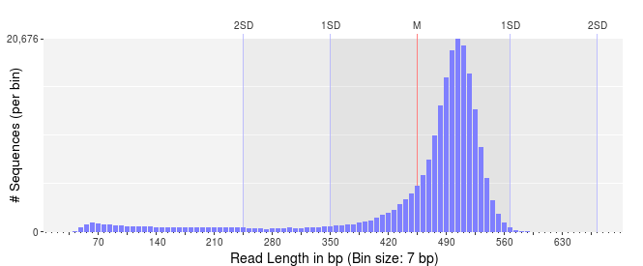
Distribution of read lengths
Notes:
Good distribution

Slide 15
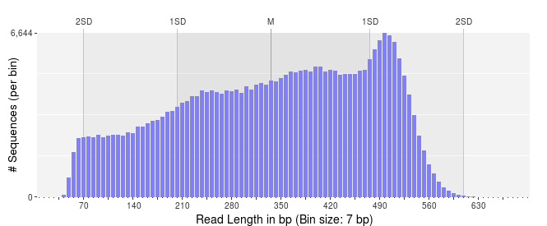
Distribution of read lengths
Notes:
Not so great

Slide 16
Quality Control (Q/C)
You need to know if your data are good!
Example software that give you read metrics
FastQC
fastp
Seqtk
Many others that are not mainstream
Fasten (Lee Katz’s)
fastq-scan (Robert Petite)
Notes:
https://github.com/OpenGene/fastp
https://opengene.org/fastp/fastp.html

Slide 17
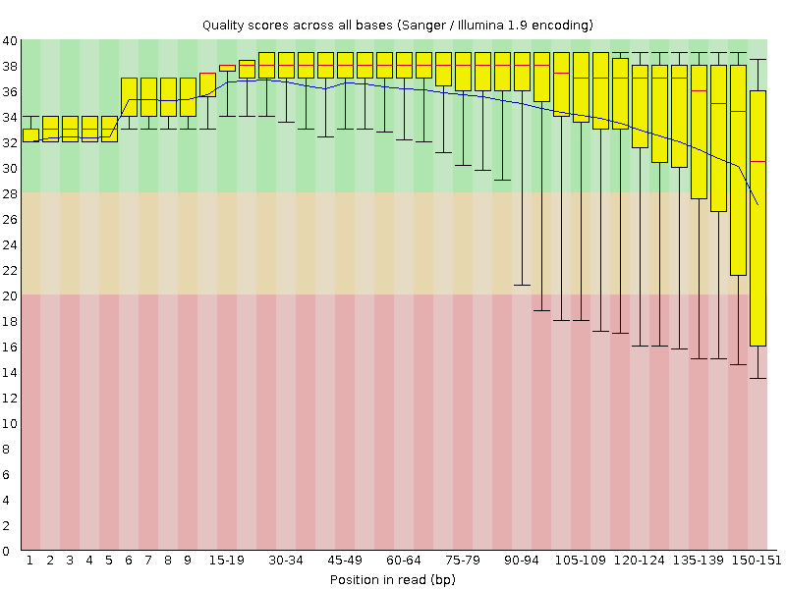
Q/C: phred score per read length
FastQC output
Notes:
good

Slide 18
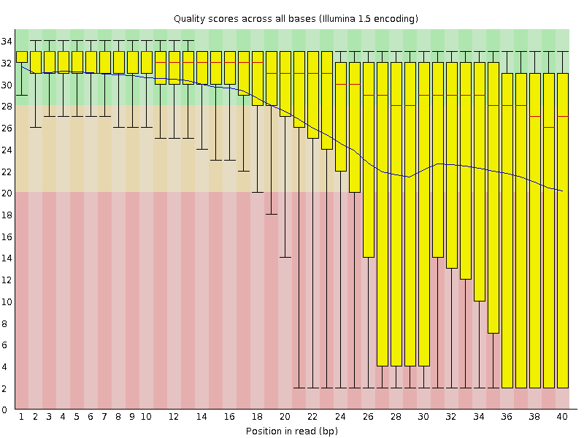
Q/C: phred score per read length
FastQC output
Notes:
not so great

Slide 19
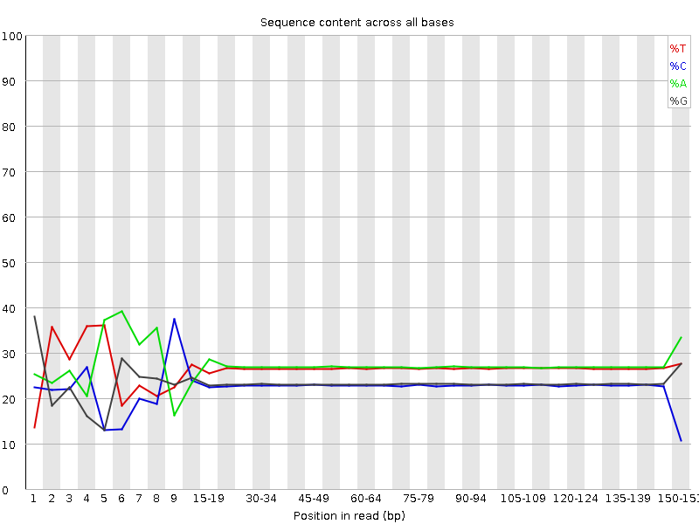
Q/C: ACGT percentages per read length
FastQC output
Notes:
Good. Nice flat lines.
shaky at the beginning and ends and so they need to be trimmed

Slide 20
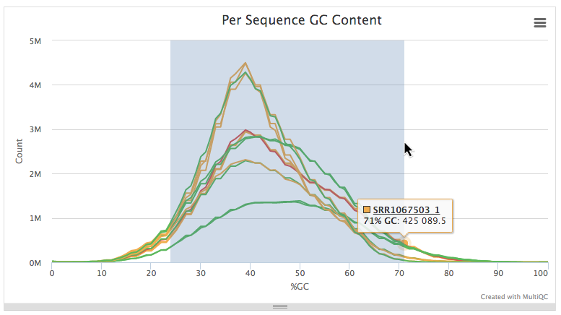
Q/C: GC percentage per read

Slide 21
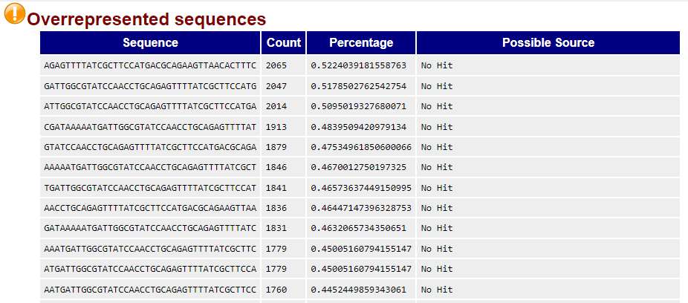
Q/C: Overrepresented sequences
Notes:
Not great but also these can be removed with a trimming tool

Slide 22
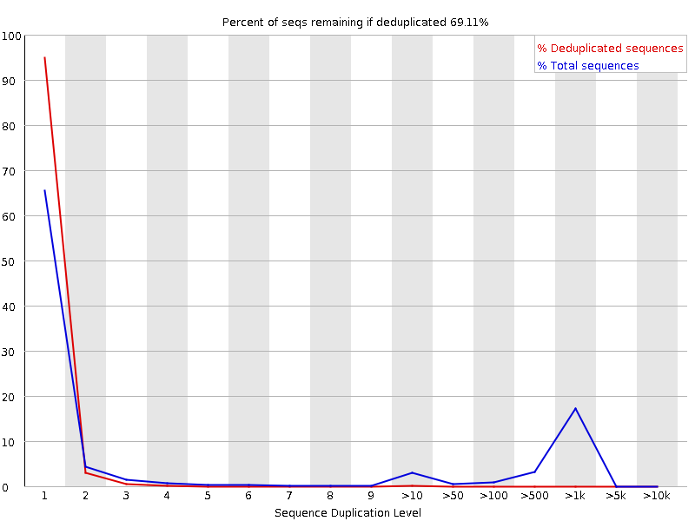
Q/C: duplicated sequences

Slide 23
Multihealing - Cleaning reads
Wagner DD, Carleton HA, Trees E, Katz LS. 2021. Evaluating whole-genome sequencing quality metrics for enteric pathogen outbreaks. PeerJ 9:e12446 https://doi.org/10.7717/peerj.12446
Notes:
Wagner et al 2022

Slide 24

Major methods of healing reads
Trimming
Filtering
Correction
Note: for this section we will focus on Illumina paired end reads
Notes:
People informally call trimming and cleaning as “cleaning”

Slide 25
Paired end reads diagram

Slide 26
Trimming
Remove bp from sides of read
Poly A/T tails
Ns
Until an average quality
Until a quality threshold
Notes:
Interactive: where would you trim until if this were a single read? You can use the line where it curves down to Q30 at position 20 as an example

Slide 27
Filtering
Removing reads
Thresholds
Average quality score
Read length
Boosts overall quality
instead of garbage in, garbage out, you get closer to quality in, quality out

Slide 28
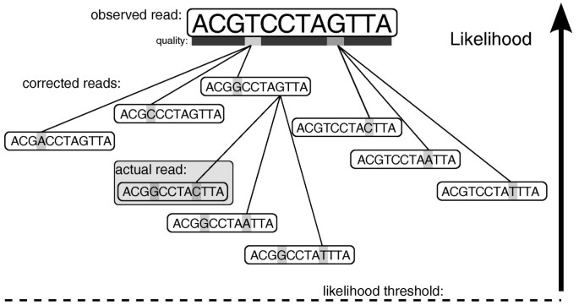
Correction
Compare multiple reads
Alter minority variants
Kelley, D.R., Schatz, M.C. & Salzberg, S.L. Quake: quality-aware detection and correction of sequencing errors. Genome Biol 11, R116 (2010). https://doi.org/10.1186/gb-2010-11-11-r116

Slide 29
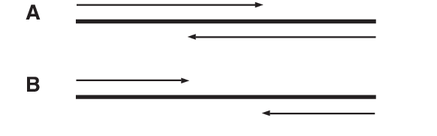
Overlap consensus
Find any R1/R2 reads that overlap
Find consensus sequence
Make very long read
Zhang, Jiajie et al. “PEAR: a fast and accurate Illumina Paired-End reAd mergeR.” Bioinformatics 30 (2014): 614 - 620.

Slide 30
Why heal the reads?
garbage in, garbage out
SNP analysis
Assembly
Other
Further reading: Wagner DD, Carleton HA, Trees E, Katz LS. 2021. Evaluating whole-genome sequencing quality metrics for enteric pathogen outbreaks. PeerJ 9:e12446 https://doi.org/10.7717/peerj.12446
Notes:
SNP analysis: fewer noisy reads in each position: more reliable SNP calls
Assembly: fewer noisy reads and therefore more confident assembly in overlapping reads
Other, e.g., MLST analysis: more confident base calls and therefore more confident allele calls

Slide 31
Assembly Concepts

Slide 32
Assembly
Overlaps between reads or between nodes in a graph
Generate contigs (contiguous sequences)
Generate scaffolds
NNN N

Slide 33
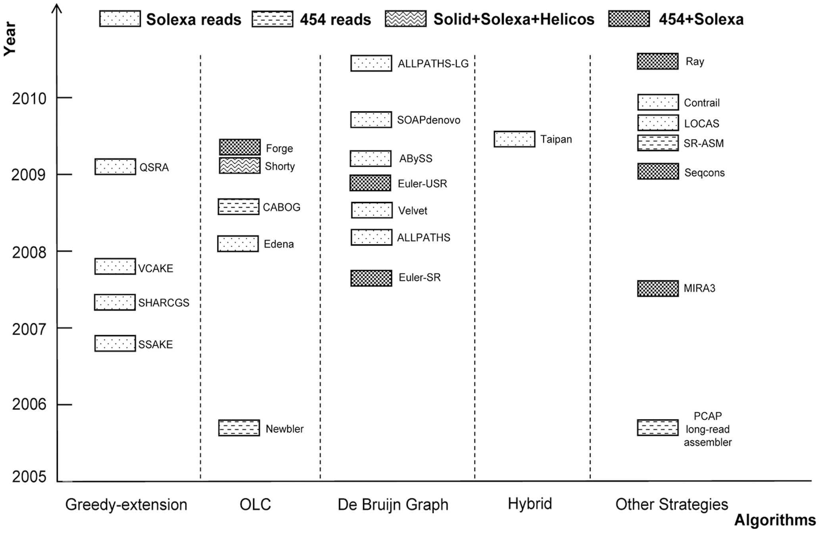
Further reading: Zhang et al 2011 Plos One; Miller et al 2011 Genomics

Slide 34
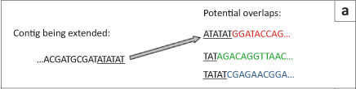
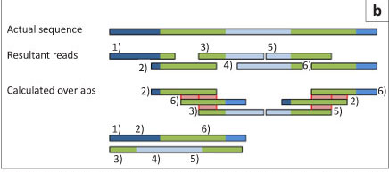
Overlap-layout-consensus
Great at longer, fewer, imperfect reads, e.g., Ion Torrent, 454, PacBio
Stephen Schlebusch, Nicola Illing. Next generation shotgun sequencing and the challenges of de novo genome assembly. South African Journal of Science. Vol. 108

Slide 35
Derive consensus sequence
TAGATTACACAGATTACTGA-TTGATGGCGTAA-CTA TAGATTACACAGATTACTGACTTGATGGCGTAAACTA
TAG-TTACACAGATTATTGACTTCATGGCGTAA-CTA
TAGATTACACAGATTACTGACTTGATGGCGTAA-CTA
TAGATTACACAGATTACTGACTTGATGGGGTAA-CTA
TAGATTACACAGATTACTGACTTGATGGCGTAA-CTA
Derive each consensus base by weighted voting
Slide adapted from Andrey Kislyuk, http://www.compgenomics2009.biology.gatech.edu/images/1/12/2009-01-14-compgenomics-kislyuk.pdf

Slide 36
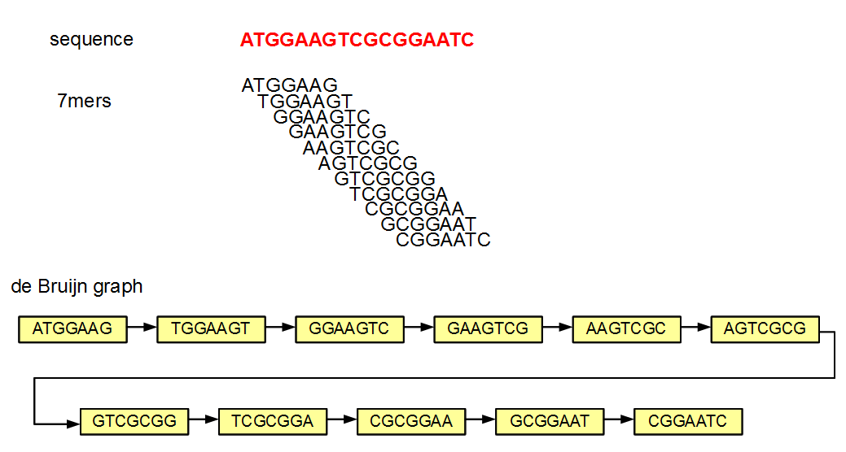
De bruijn (kmer)
Great at shorter, numerous, less error-prone reads, e.g., Illumina
http://www.homolog.us/blogs/blog/2012/06/17/an-intuitive-explanation-for-running-de-bruijn-assembler-with-varying-k-mer-sizes/

Slide 37
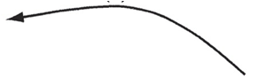
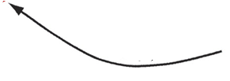
Another way to look at de bruijn assembly
D (1)
A (1)
B (2)
C (3)
E (2)
G (1)
F (1)
Unipath graph of the 1.8-Mb genome of C. jejuni
Possible paths:
ABCDBCEFCEG
ABCEFCDBCEG
Butler J et al. (2008) ALLPATHS: De novo assembly of whole-genome shotgun microreads. Genome Res. 18:810-820
Notes:
Slide taken from Butler J et al. (1998) ALLPATHS: De novo assembly of whole-genome shotgun microreads. Genome Res. 18:810-820
Unipath graph of the 1.8-Mb genome of C. jejuni for K = 6000, which is also the best possible assembly of its genome from unpaired reads of length 6001. The genome was treated as linear to simplify computation. Each unipath is labeled with its number of copies (multiplicity) in the genome and with a letter to facilitate discussion. Formally, the graph also includes a reversed copy corresponding to the reverse-complemented sequence (data not shown). The middle horizontal edge represents a 6.2-kb perfect repeat present three times in the genome. This edge is present exactly because the reads are shorter than the repeat. If the reads were longer than 6.2 kb, then the graph would be a single edge. This graph (along with edge sequences and multiplicities) represents exactly what can be known from the data: There are exactly two ways to traverse the graph from end to end, ABCDBCEFCEG and ABCEFCDBCEG, but it is not possible to know from the data which of these alternatives represents the true genome. When K = 20, one instead has 4161 unipaths in total, and the graph is far too tangled to display, or even to separate the genome from its complemented copy.

Slide 38
Another way to look at de bruijn assembly
D (1)
A (1)
B (2)
C (3)
E (2)
G (1)
F (1)
Unipath graph of the 1.8-Mb genome of C. jejuni
Possible paths:
ABCDBCEFCEG
ABCEFCDBCEG
Butler J et al. (2008) ALLPATHS: De novo assembly of whole-genome shotgun microreads. Genome Res. 18:810-820
Notes:
Slide taken from Butler J et al. (1998) ALLPATHS: De novo assembly of whole-genome shotgun microreads. Genome Res. 18:810-820
Unipath graph of the 1.8-Mb genome of C. jejuni for K = 6000, which is also the best possible assembly of its genome from unpaired reads of length 6001. The genome was treated as linear to simplify computation. Each unipath is labeled with its number of copies (multiplicity) in the genome and with a letter to facilitate discussion. Formally, the graph also includes a reversed copy corresponding to the reverse-complemented sequence (data not shown). The middle horizontal edge represents a 6.2-kb perfect repeat present three times in the genome. This edge is present exactly because the reads are shorter than the repeat. If the reads were longer than 6.2 kb, then the graph would be a single edge. This graph (along with edge sequences and multiplicities) represents exactly what can be known from the data: There are exactly two ways to traverse the graph from end to end, ABCDBCEFCEG and ABCEFCDBCEG, but it is not possible to know from the data which of these alternatives represents the true genome. When K = 20, one instead has 4161 unipaths in total, and the graph is far too tangled to display, or even to separate the genome from its complemented copy.

Slide 39

Recap of assembly
reads
Paired end reads
contigs
Scaffold
NNNNNNNNNN

Slide 40
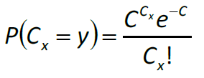
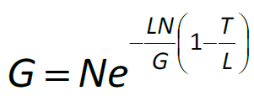
One problem: randomly low coverage (Lander-Waterman)
Assuming random distribution of reads and ignoring repeat resolution issues,
G= genome length
L = length of a single read
N= number of reads sequenced
T= minimum overlap to align the reads together
Then overall coverage is C = LN/G
Coverage for any given base obeys the Poisson distribution:
The number of gaps(bases with 0 coverage) is:
A good Lander-Waterman reference: http://www.math.ucsd.edu/~gptesler/186/shotgun_08-handout.pdf
Lander and Waterman (1988). Genomic Mapping by Fingerprinting random clones: a mathematical analysis. Genomics 2 pp. 231-239
http://www.cmb.usc.edu/papers/msw_papers/msw-081.pdf

Slide 41
Major Problem: what is the correct path?
D (1)
A (1)
B (2)
C (3)
E (2)
G (1)
F (1)
Unipath graph of the 1.8-Mb genome of C. jejuni
Possible paths:
ABCDBCEFCEG
ABCEFCDBCEG
Butler J et al. (2008) ALLPATHS: De novo assembly of whole-genome shotgun microreads. Genome Res. 18:810-820
Notes:
Slide taken from Butler J et al. (1998) ALLPATHS: De novo assembly of whole-genome shotgun microreads. Genome Res. 18:810-820
Unipath graph of the 1.8-Mb genome of C. jejuni for K = 6000, which is also the best possible assembly of its genome from unpaired reads of length 6001. The genome was treated as linear to simplify computation. Each unipath is labeled with its number of copies (multiplicity) in the genome and with a letter to facilitate discussion. Formally, the graph also includes a reversed copy corresponding to the reverse-complemented sequence (data not shown). The middle horizontal edge represents a 6.2-kb perfect repeat present three times in the genome. This edge is present exactly because the reads are shorter than the repeat. If the reads were longer than 6.2 kb, then the graph would be a single edge. This graph (along with edge sequences and multiplicities) represents exactly what can be known from the data: There are exactly two ways to traverse the graph from end to end, ABCDBCEFCEG and ABCEFCDBCEG, but it is not possible to know from the data which of these alternatives represents the true genome. When K = 20, one instead has 4161 unipaths in total, and the graph is far too tangled to display, or even to separate the genome from its complemented copy.

Slide 42
Major Problem: what is the correct path?
D (1)
A (1)
B (2)
C (3)
E (2)
G (1)
F (1)
Unipath graph of the 1.8-Mb genome of C. jejuni
Possible paths:
ABCDBCEFCEG
ABCEFCDBCEG
Butler J et al. (2008) ALLPATHS: De novo assembly of whole-genome shotgun microreads. Genome Res. 18:810-820
Notes:
Slide taken from Butler J et al. (1998) ALLPATHS: De novo assembly of whole-genome shotgun microreads. Genome Res. 18:810-820
Unipath graph of the 1.8-Mb genome of C. jejuni for K = 6000, which is also the best possible assembly of its genome from unpaired reads of length 6001. The genome was treated as linear to simplify computation. Each unipath is labeled with its number of copies (multiplicity) in the genome and with a letter to facilitate discussion. Formally, the graph also includes a reversed copy corresponding to the reverse-complemented sequence (data not shown). The middle horizontal edge represents a 6.2-kb perfect repeat present three times in the genome. This edge is present exactly because the reads are shorter than the repeat. If the reads were longer than 6.2 kb, then the graph would be a single edge. This graph (along with edge sequences and multiplicities) represents exactly what can be known from the data: There are exactly two ways to traverse the graph from end to end, ABCDBCEFCEG and ABCEFCDBCEG, but it is not possible to know from the data which of these alternatives represents the true genome. When K = 20, one instead has 4161 unipaths in total, and the graph is far too tangled to display, or even to separate the genome from its complemented copy.

Slide 43
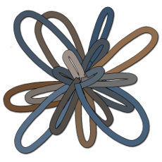
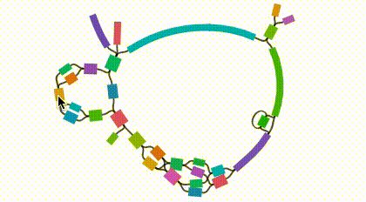
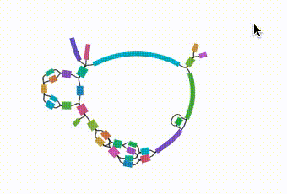
Bandage: Software for viewing assemblies
https://github.com/rrwick/Bandage

Slide 44
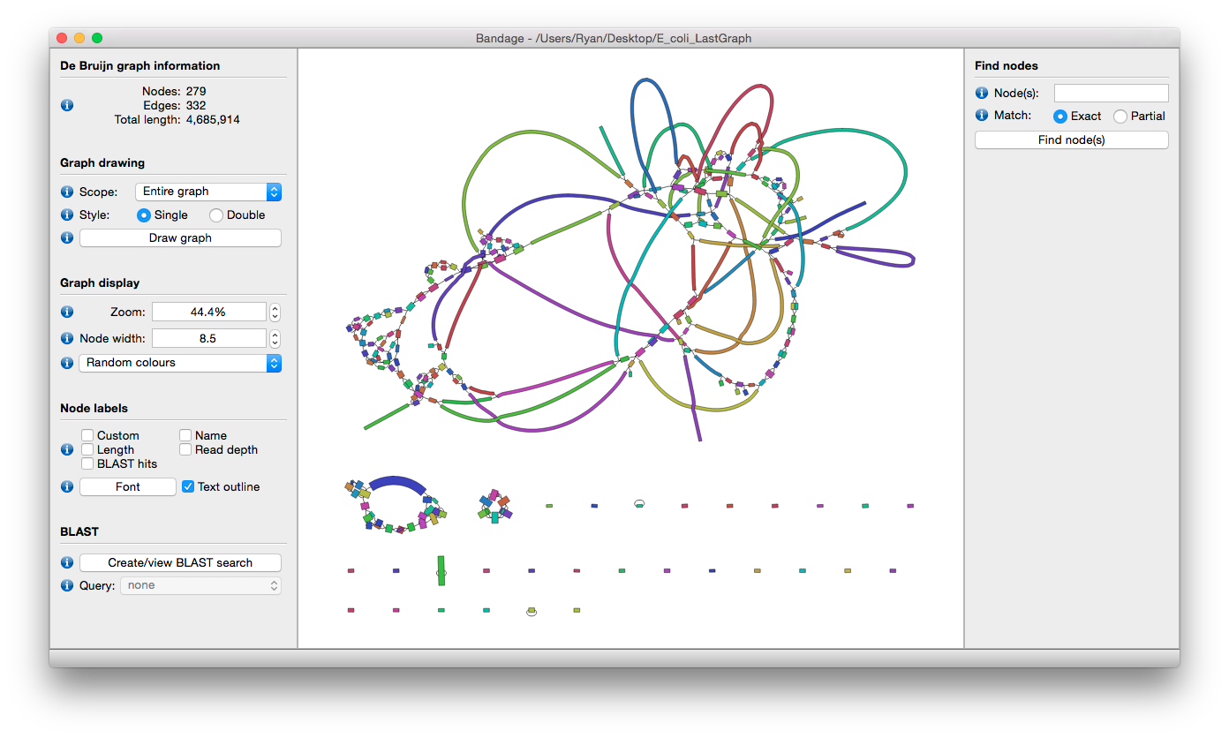
Bandage main display
Summary stats
Graph drawing
Graph display
Node labels
BLAST
https://github.com/rrwick/Bandage/wiki

Slide 45

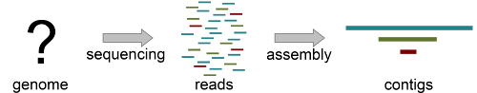
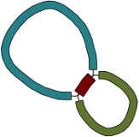

Contiguity viz in Bandage
Copied from https://github.com/rrwick/Bandage/wiki/Simple-example
Notes:
For a simple case, imagine a bacterial genome that contains a single repeated element in two separate places in the chromosome:
A researcher (who does not yet know the structure of the genome) sequences it, and the resulting 100 bp reads are assembled with a de novo assembler:
Because the repeated element is longer than the sequencing reads, the assembler was not able to reproduce the original genome as a single contig. Rather, three contigs are produced: one for the repeated sequence (even though it occurs twice) and one for each sequence between the repeated elements.
Given only the contigs, the relationship between these sequences is not clear. However, the assembly graph contains additional information which is made apparent in Bandage:
There are two principal underlying sequences compatible with this graph: two separate circular sequences that share a region in common, or a single larger circular sequence with an element that occurs twice:
Additional knowledge, such as information on the approximate size of the bacterial chromosome, can help the researcher to rule out the first alternative. In this way, Bandage has assisted in turning a fragmented assembly of three contigs into a completed genome of one sequence.

Slide 46
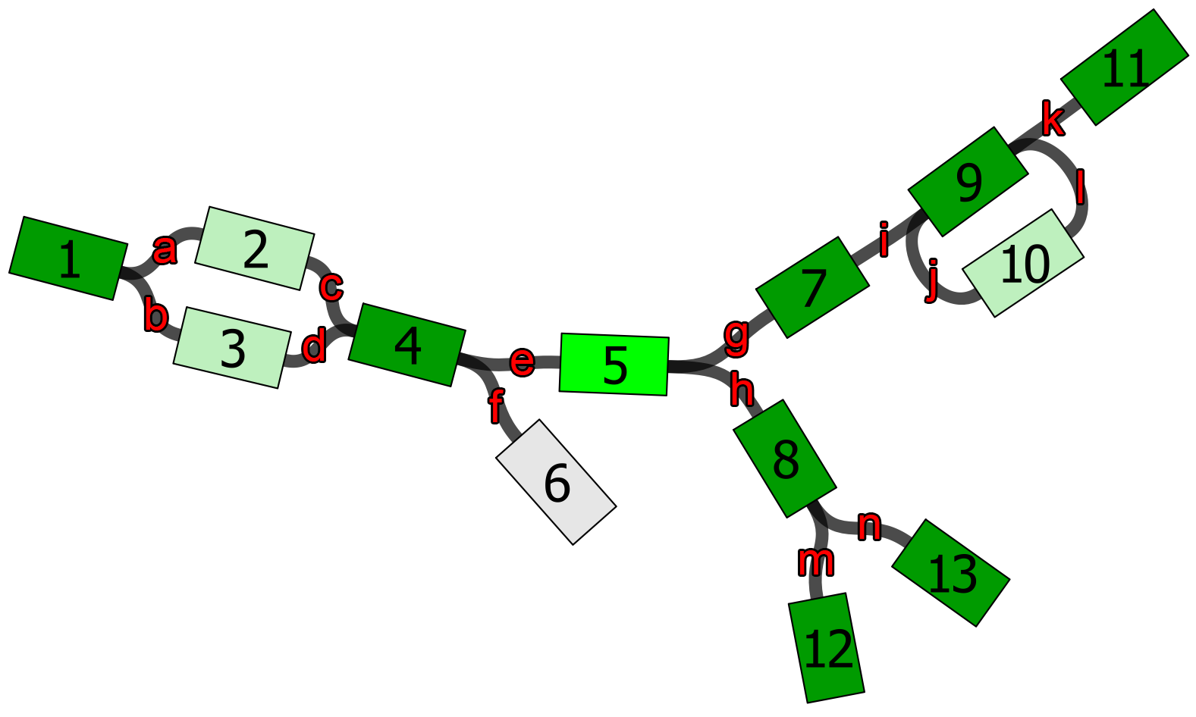
Which of the following are contiguous?
Node1 and Node 5
Node 1 is contiguous with node 5. When leaving node 5 via edge (e), all possible paths encounter node 1.
Node 12 and Node 5
Node 12 is contiguous with node 5. When leaving node 12 via edge (m), all possible paths encounter node 5.
Node 2 and Node 5
Node 2 is possibly contiguous with node 5. When leaving node 5 via edge (e), only some paths encounter node 2. This is also the case for the opposite direction: when leaving node 2 via edge (c), only some paths encounter node 5.
Node 6 and Node 5
Node 6 is not contiguous with node 5. There are no paths connecting those two nodes. Note that a path in the assembly graph must enter a node on one end and leave via the other. For example, the path 5-4-6 via edges (e) and (f) is not valid.
https://github.com/rrwick/Bandage/wiki/Determining-contiguity

Slide 47
Wrap up
We learned
Sequencing instruments
QC
Multi-healing
Assembly concepts
Homework!

Slide 48
Professional Development slide

Slide 49
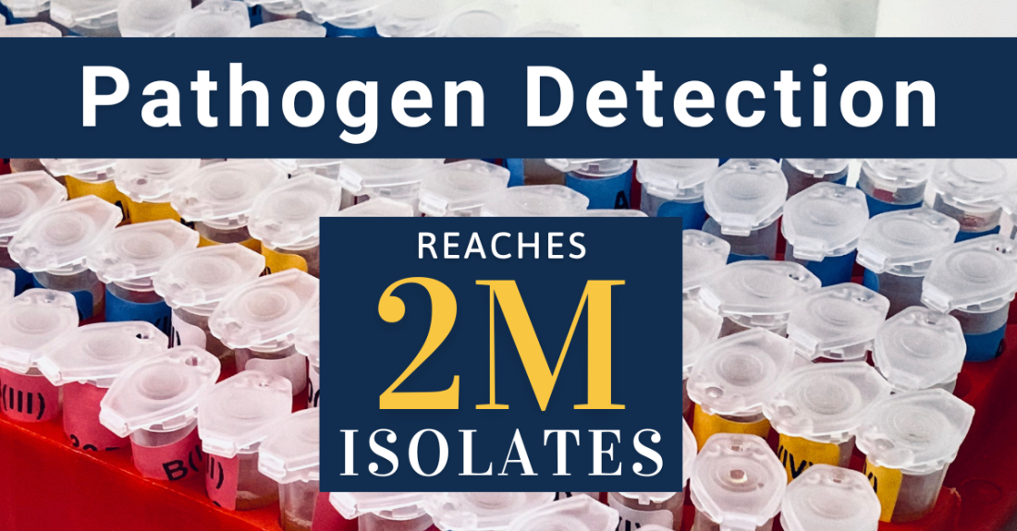
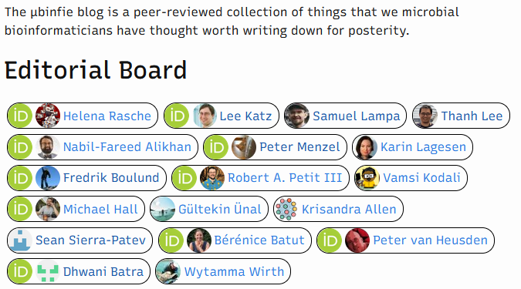
Blogs
https://ncbiinsights.ncbi.nlm.nih.gov
https://ubinfie.github.io/

